Slide 1

Cache memory and virtual memory: paging and segmentation
Computer Organization and Architecture | Memory & I/O Organization
Course: Computer Organization and Architecture | Chapter: Memory & I/O Organization | Program: Bachelor of Engineering
DISCOVER · LEARN · EMPOWER
Notes:
Welcome to today's lecture on memory organization. We will dive deep into how modern systems manage speed and capacity through cache, paging, and segmentation. This session is designed to help you analyze these critical components for your engineering exams.

Slide 2
Course Outcomes
SLIDE 2 / 10
Course Outcome
CO | BT LEVEL | DESCRIPTION
CO1 | BT3 | Apply number systems and digital logic to design basic digital circuits
CO2 | BT4 | Analyze register organization and instruction set architecture
CO3 | BT3 | Implement computer arithmetic algorithms and floating-point operations
CO4 | BT5 | Analyze memory hierarchy and input-output organization
CO5 | BT6 | Evaluate control unit design and pipelining performance
Chandigarh University
2 / 10
Notes:
Our primary goal for this lecture is to meet Course Outcome 4. You will learn to analyze the memory hierarchy and how input-output organization interacts with virtual memory techniques. This analysis is crucial for designing efficient computer systems.

Slide 3
Learning Objectives
SLIDE 3 / 10
Learning Outcomes
1
Evaluate the role of cache memory in reducing average access time.
2
Analyze the differences between paging and segmentation in virtual memory.
3
Calculate page fault rates and effective memory access ×.
4
Compare the advantages of segmentation over paging for program structure.
5
Synthesize memory management strategies for specific application requirements.
Chandigarh University
3 / 10
Notes:
By the end of this session, you will be able to evaluate how cache hits improve performance. You will analyze the structural differences between paging and segmentation. We will also calculate page fault rates to understand system bottlenecks.

Slide 4
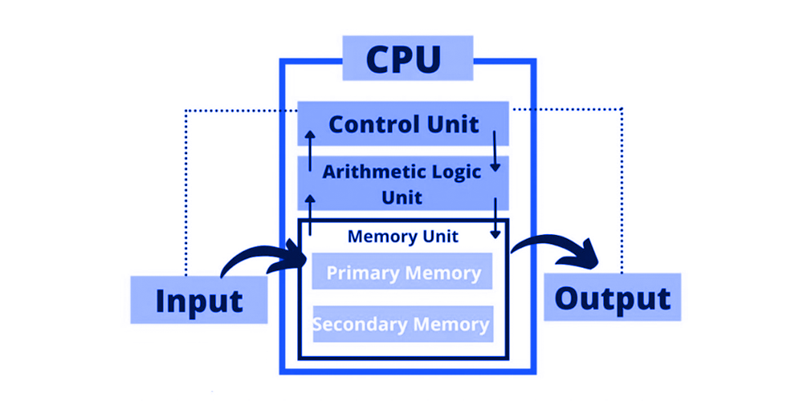
Lecture
SLIDE 4 / 10
Cache Memory Fundamentals
1
Cache is a small, fast memory located between CPU and main memory.
2
It stores copies of frequently accessed data blocks from main memory.
3
Hit ratio is the fraction of memory accesses found in the cache.
4
Miss penalty is the time required to fetch data from main memory.
5
Locality of reference ensures cache effectiveness for sequential and temporal access.
Block Diagram of Computer: Components and Functions Explained
Chandigarh University
4 / 10
Notes:
Think of cache as a student's desk where they keep the books they are currently reading. If the book is on the desk, it is a hit; if not, they must walk to the library, which is a miss. A high hit ratio means the student rarely leaves their desk.

Slide 5
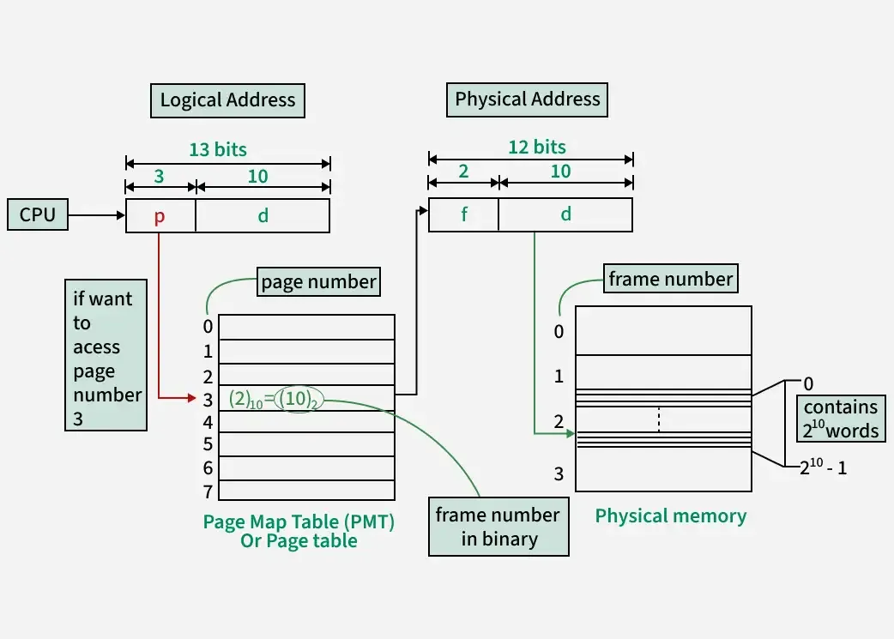
Lecture
SLIDE 5 / 10
Virtual Memory Paging
1
Paging divides logical address space into fixed-size blocks called pages.
2
Physical memory is divided into equal-sized blocks called frames.
3
Page table maps logical page numbers to physical frame numbers.
4
Hardware uses a Translation Lookaside Buffer to speed up address translation.
5
Paging eliminates external fragmentation but may cause internal fragmentation.
Source: media.geeksforgeeks.org
Chandigarh University
5 / 10
Notes:
In paging, the operating system treats memory like a grid of identical tiles. A program's page 5 might be stored in frame 12, and the page table tells the hardware exactly where to find it. This fixed size simplifies memory allocation significantly.

Slide 6
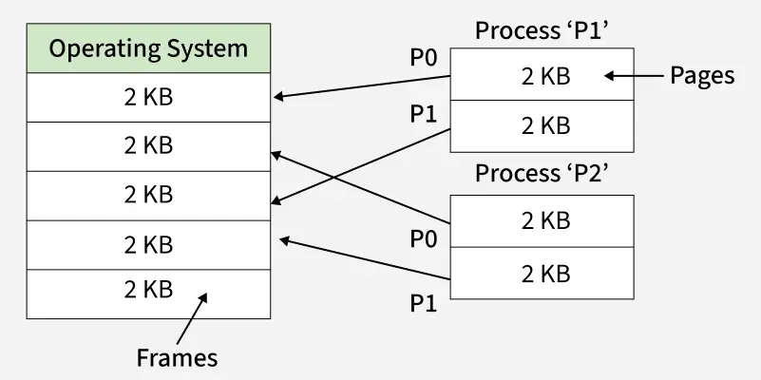
Lecture
SLIDE 6 / 10
Virtual Memory Segmentation
1
Segmentation divides memory into variable-sized logical units called segments.
2
Each segment represents a logical unit like a function or array.
3
Segment table stores the base address and limit for each segment.
4
Segmentation supports user-defined logical structures and protection mechanisms.
5
It suffers from external fragmentation requiring compaction to reclaim space.
Source: media.geeksforgeeks.org
Chandigarh University
6 / 10
Notes:
Unlike paging, segmentation respects the logical structure of your program. A segment for a function might be 500 bytes, while an array might be 2000 bytes. This flexibility allows for better protection but introduces the challenge of external fragmentation.

Slide 7
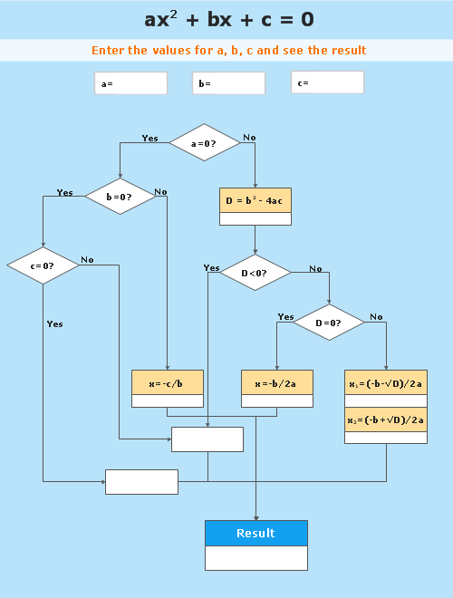
Lecture
SLIDE 7 / 10
Effective Access Time Calculation
GOVERNING EQUATION
Effective Access Time = (Hit Ratio × Cache Time) + (Miss Ratio × Miss Penalty)
EXAMPLE
Hit ratio 0.95, Cache time 10ns, Miss penalty 100ns.
CALCULATION
EAT = (0.95 × 10) + (0.05 × 100) = 9.5 + 5 = 14.5ns.
• Miss Penalty includes main memory access time plus data transfer time.
• Higher hit ratios significantly reduce the average time to access data.
Source: www.conceptdraw.com
Chandigarh University
7 / 10
Notes:
Let's look at a concrete example. If your cache is 95% effective, you save a lot of time. The calculation shows that even with a slow main memory, a high hit ratio keeps the average access time very low, around 14.5 nanoseconds in this case.

Slide 8
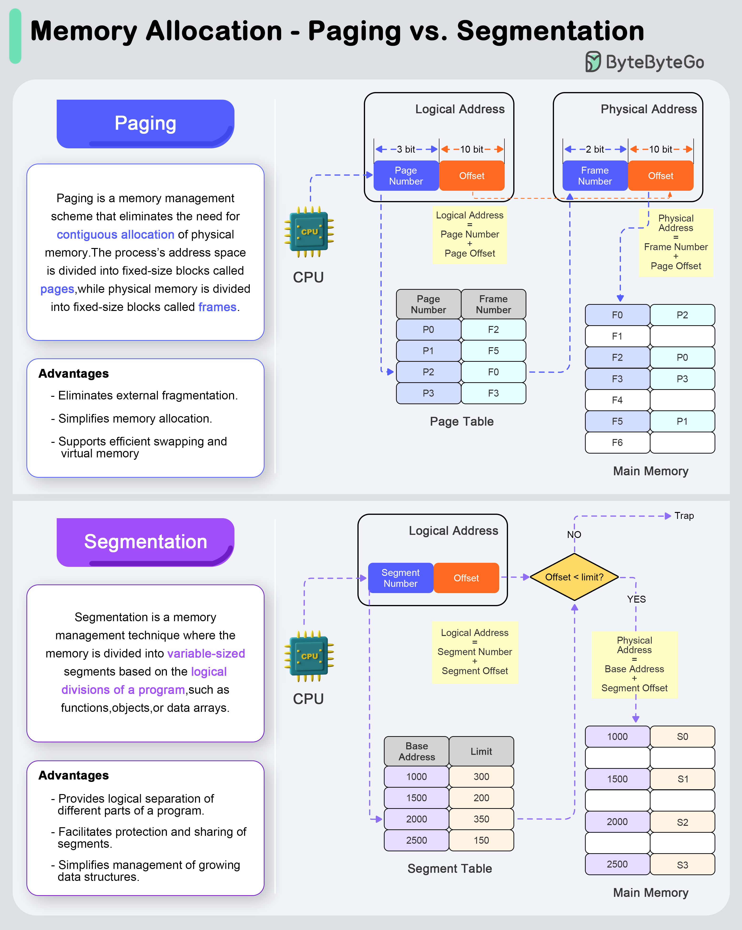
Lecture
SLIDE 8 / 10
Paging vs Segmentation Comparison
1
Paging uses fixed sizes; Segmentation uses variable sizes based on logic.
2
Paging hides physical structure; Segmentation exposes logical program structure.
3
Paging causes internal fragmentation; Segmentation causes external fragmentation.
4
Paging requires page tables; Segmentation requires segment tables with limits.
5
Paging is easier to implement; Segmentation offers better protection features.
Source: assets.bytebytego.com
Chandigarh University
8 / 10
Notes:
The key difference lies in how they view memory. Paging sees memory as a uniform pool of blocks, while segmentation sees it as a collection of logical units. You choose paging for simplicity and segmentation for logical organization and protection.

Slide 9
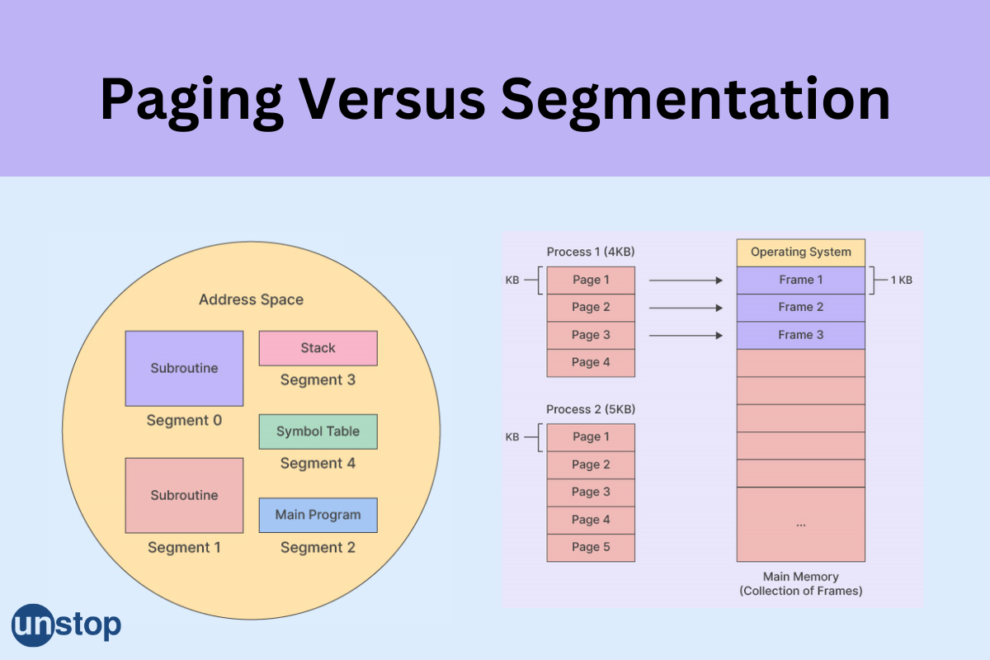
Lecture
SLIDE 9 / 10
Key Takeaways
1
Cache memory drastically reduces average access time through locality of reference.
2
Paging uses fixed blocks to eliminate external fragmentation in physical memory.
3
Segmentation uses variable blocks to align with logical program structures.
4
Effective access time depends heavily on the cache hit ratio.
5
Modern systems often combine paging and segmentation for optimal performance.
Source: d8it4huxumps7.cloudfront.net
Chandigarh University
9 / 10
Notes:
To summarize, cache is your speed booster, while paging and segmentation are your memory management strategies. Remember that paging simplifies allocation, whereas segmentation aligns with your code's logic. Mastering these concepts is essential for analyzing memory hierarchy.

Slide 10
Lecture
SLIDE 10 / 10
References
COMPUTER ORGANIZATION AND DESIGN
The Hardware/Software Interface — David A. Patterson, John L. Hennessy
COMPUTER ARCHITECTURE
A Quantitative Approach — John L. Hennessy, David A. Patterson
• Computer Organization and Architecture — William Stallings
• Computer System Architecture — M. Morris Mano & Rajib Mall
• Computer Organization — Carl Hamacher, Zvonko Vranesic, Safwat Zaky
Chandigarh University
10 / 10
Notes:
These five textbooks provide the foundational knowledge for the concepts we discussed today. I encourage you to read the chapters on memory management in Stallings and Hennessy for deeper insights. These resources will support your analysis of computer organization.

